Slide 1

Key characteristics of carcinogens as a basis for organizing data on mechanisms of carcinogenesis
Martyn Smith and Kathryn Guyton*
School of Public Health, Berkeley CA, USA
*IARC, Lyon, France
martynts@berkeley.edu
http://superfund.berkeley.edu

Slide 2
How do we decide if a chemical is a carcinogen?
Human studies – epidemiology
Animal studies – usually rodent bioassays – lifetime chronic or shorter transgenic assays? – omics?
In vitro studies – e.g. Tox21/Toxcast
Mechanistic data – Biological plausibility – Could this be sufficient?

Slide 3
Who decides if a chemical is a carcinogen?
International Agency for Research on Cancer (IARC –WHO) – Groups 1, 2A, 2B, 3, 4
EPA – Groups A, B1, B2, C etc.
NTP – Annual List of Carcinogens
Cal Prop 65 – Often by adopting other authorities
Others – FDA, EU, Japan (?) etc.

Slide 4
Definitions of the IARC Classifications

Slide 5
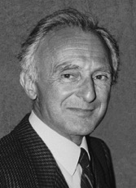
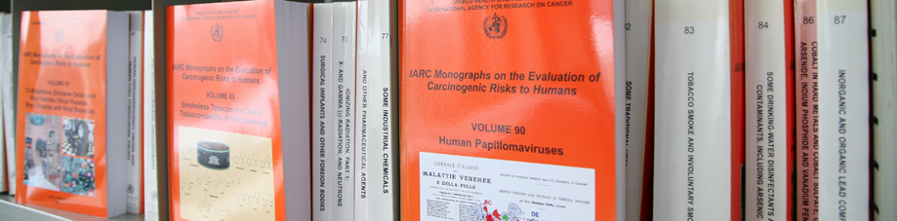
“The Encyclopaedia of Carcinogens”
Agents are recommended by international advisors based on:
  Evidence of human exposure
  Some evidence or suspicion of carcinogenicity
More than 980 agents have been evaluated
  118 are carcinogenic to humans (Group 1)
  79 are probably carcinogenic to humans (Group 2A)
  290 are possibly carcinogenic to humans (Group 2B)
  503 are not classifiable as to its carcinogenicity to humans (Group 3)
  1 is classified as probably not carcinogenic to humans (Group 4)
National and international health agencies use the Monographs
  To identify carcinogens
  To prevent exposure to known or suspected carcinogens
Lorenzo Tomatis
1929-2007
Notes:
Soon after the IARC was founded 50 years ago, Lorenzo Tomatis had the great idea of creating a uniform classification system for carcinogens, based on objective criteria

Slide 6




How Are the IARC Monograph
Evaluations Conducted?
Procedural guidelines for participant selection, conflict of interest, stakeholder involvement & meeting conduct
Separate criteria for review of human, animal and mechanistic evidence
Decision process for overall evaluations
??
Preamble to the IARC Monographs (2006): http://monographs.iarc.fr/ENG/Preamble/index.php

Slide 7
What Evidence is Considered?
Overall evaluation
Cancer in humans
Cancer in animals
Cancer Mechanisms
Exposure Data
Preamble to the IARC Monographs (2006): http://monographs.iarc.fr/ENG/Preamble/index.php

Slide 8
How Is Evidence Evaluated?
Cancer in
humans
Cancer in
experimental animals
Mechanistic and
other relevant data
—Part B, Section 6(c)
• Are the mechanistic data “weak,” “moderate,” or “strong”?
Have the mechanistic events been established? Are there consistent results in different experimental systems? Is the overall database coherent?
Has each mechanism been challenged experimentally? Do studies demonstrate that suppression of key mechanistic processes leads to suppression of tumour development?
• Is the mechanism likely to be operative in humans?
Are there data from exposed humans or human systems?
Consider alternative explanations before concluding that tumours in experimental animals are not relevant to humans
Notes:
The categories for mechanistic data are strong, moderate or weak, reflecting the level of mechanistic support for a causal relationship. The evaluation of these data, as for studies of cancer in humans and animals, also involves ideas of consistency and coherence

Slide 9
Mechanistic Data Are Pivotal When Human Data Are Not Sufficient (Example 1)
EVIDENCE IN EXPERIMENTAL ANIMALS
Sufficient
Limited
Inadequate
Group 1 (carcinogenic to humans)
Sufficient
Limited
Group 2A
(probably carcinogenic)
Group 2B (possibly carcinogenic)
(exceptionally, Group 2A)
EVIDENCE IN HUMANS
Inadequate
Group 2B
(possibly carcinogenic)
Group 3 (not classifiable)
Strong supporting evidence in exposed humans (e.g. EtO, NNK, NNN, Dioxin)
Notes:
Mechanistic data are taken into account at the next stage: if the human data are less than sufficient, mechanistic evidence can modify the default evaluation based on human and animal data. The Preamble provides guidance for how this is done. For example, strong mechanistic evidence from studies of exposed humans can result in an upgrade to Group 1 from 2A or even 2B if there is sufficient evidence in animals.

Slide 10
IARC Group 1 Classifications
Based on Different Mechanisms
Agent | Mechanistic Rationale | Year (Vol)
Ethylene oxide | Genotoxic, cytogenetic effects in lymphocytes of workers | 1994 (Vol 60)
NNN and NNK | Uptake, metabolism, DNA/haemoglobin adducts in smokeless tobacco users | 2004 (Vol 89)
Agent | Mechanistic Rationale | Year
2,3,7,8-TCDD | Ah receptor binding, subsequent effects | 1997 (Vol 69)
http://monographs.iarc.fr

Slide 11
Mechanistic Data Are Pivotal When Human Data Are Not Sufficient (Example 2)
EVIDENCE IN EXPERIMENTAL ANIMALS
Sufficient
Limited
Inadequate
Group 1 (carcinogenic to humans)
Sufficient
Limited
Group 2A
(probably carcinogenic)
Group 2B (possibly carcinogenic)
(exceptionally, Group 2A)
EVIDENCE IN HUMANS
Inadequate
Group 2B
(possibly carcinogenic)
Group 3 (not classifiable)
Strong evidence; mechanism also operates in humans (e.g. Dibenzanthracene, nitrosodiethylamine)
Notes:
As another example, if there is sufficient evidence in animals and strong mechanistic evidence from experimental studies in animals or in vitro, but not in exposed humans, an upgrade from 2B to 2A is possible.

Slide 12
Mechanistic Data Are Pivotal When Human Data Are Not Sufficient (Example 3)
EVIDENCE IN EXPERIMENTAL ANIMALS
Sufficient
Limited
Inadequate
Group 1 (carcinogenic to humans)
Sufficient
Limited
Group 2A
(probably carcinogenic)
Group 2B (possibly carcinogenic)
(exceptionally, Group 2A)
EVIDENCE IN HUMANS
Inadequate
Group 2B
(possibly carcinogenic)
Group 3 (not classifiable)
Strong evidence: mechanism in animals DOES NOT operate in humans (e.g. Limonene, saccharin)
Notes:
Finally, it’s important to mention that a Group 2B agent classified only on the basis of sufficient animal data can be DOWNGRADED if there is strong evidence that the mechanism observed in animals doesn’t operate in humans.

Slide 13

Mechanistic Data: Challenges
Different human carcinogens may operate through distinct mechanisms
Many human carcinogens act via multiple mechanisms
There is no broadly accepted, systematic method for evaluating mechanistic data to support cancer hazard identification
IARC Monographs
Volume 100

Slide 14
So Many Studies, So Little Time…
  How to search systematically for relevant mechanisms?
  How to bring uniformity across assessments?
  How to analyze the voluminous mechanistic database efficiently?
  How to avoid bias towards favored mechanisms
Cancer in
humans
Cancer in animals
Mechanistic data
10-100s of studies
10s of studies
100s to 10,000s of studies

Slide 15
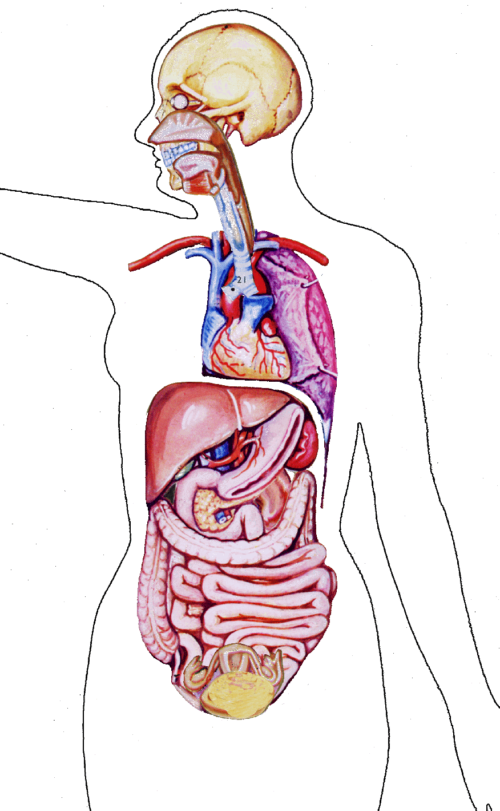

IARC Monographs Volume 100: The known causes of human cancer by organ site
Eye | Human immunodeficiency virus type 1 Ultraviolet-emitting tanning devices Welding
Brain and central nervous system | X-radiation, gamma-radiation
Lung | Aluminium production Arsenic and inorganic arsenic compounds Asbestos (all forms) Beryllium and beryllium compounds Bis(chloromethyl)ether; chloromethyl methyl ether (technical grade) Cadmium and cadmium compounds Chromium (VI) compounds Coal, indoor emissions from household combustion Coal gasification Coal-tar pitch Coke production Haematite mining (underground) Iron and steel founding MOPP (vincristine-prednisone-nitrogen mustard-procarbazine mixture) Nickel compounds Painter (occupational exposure as) Plutonium Radon-222 and its decay products Rubber production industry Silica dust, crystalline Soot Sulfur mustard Tobacco smoke, secondhand Tobacco smoking X-radiation, gamma-radiation
Oral cavity | Alcoholic beverages Betel quid with tobacco Betel quid without tobacco Human papillomavirus type 16 Smokeless tobacco Tobacco smoking
Pharynx | Alcoholic beverages Betel quid with tobacco Human papillomavirus type 16 Tobacco smoking
Nasal cavity and paranasal sinus | Isopropyl alcohol manufacture using strong acids Leather dust Nickel compounds Radium-226 and its decay products Radium-228 and its decay products Tobacco smoking Wood dust
Nasopharynx | Epstein-Barr virus Formaldehyde Salted fish, Chinese-style Wood dust
Tonsil | Human papillomavirus type 16
Salivary gland | X-radiation, gamma-radiation
Thyroid | Radioiodines, including iodine-131 (exposure during childhood and adolescence) X-radiation, gamma-radiation
Larynx | Acid mists, strong inorganic Alcoholic beverages Asbestos (all forms) Tobacco smoking
Stomach | Helicobacter pylori Rubber production industry Tobacco smoking X-radiation, gamma-radiation
Mesothelioma (pleura or peritoneum) | Asbestos (all forms) Erionite Painter (occupational exposure as)
Upper aerodigestive tract | Acetaldehyde associated with consumption of alcoholic beverages
Liver (hepatocytes) | Aflatoxins Alcoholic beverages Estrogen-progestogen contraceptives Hepatitis B virus Hepatitis C virus Plutonium Thorium-232 and its decay products Tobacco smoking (in smokers and in smokers’ children) Vinyl chloride
Oesophagus | Acetaldehyde associated with consumption of alcoholic beverages Alcoholic beverages Betel quid with tobacco Betel quid without tobacco Smokeless tobacco Tobacco smoking X-radiation, gamma-radiation
Breast | Alcoholic beverages Diethylstilbestrol Estrogen-progestogen contraceptives Estrogen-progestogen menopausal therapy X-radiation, gamma-radiation
Urinary bladder | Aluminium production 4-Aminobiphenyl Arsenic and inorganic arsenic compounds Auramine production Benzidine Chlornaphazine Cyclophosphamide Magenta production 2-Naphthylamine Painter (occupational exposure as) Rubber production industry Schistosoma haematobium Tobacco smoking ortho-Toluidine X-radiation, gamma-radiation
Biliary tract | Chlonorchis sinensis Opisthorchis viverrini
Gall bladder | Thorium-232 and its decay products
Kidney | Tobacco smoking X-radiation, gamma-radiation
Colon and rectum | Alcoholic beverages Tobacco smoking X-radiation, gamma-radiation
Pancreas | Smokeless tobacco Tobacco smoking
Renal pelvis and ureter | Aristolochic acid, plants containing Phenacetin Phenacetin, analgesic mixtures containing Tobacco smoking
Anus | Human immunodeficiency virus type 1 Human papillomavirus type 16
Endometrium | Estrogen menopausal therapy Estrogen-progestogen menopausal therapy Tamoxifen
Bone | Plutonium Radium-224 and its decay products Radium-226 and its decay products Radium-228 and its decay products X-radiation, gamma-radiation
Leukaemia/ lymphoma | Azathioprine Benzene Busulfan 1,3-Butadiene Chlorambucil Cyclophosphamide Cyclosporine Epstein-Barr virus Etoposide with cisplatin and bleomycin Fission products, including Strontium-90 Formaldehyde Helicobacter Pylori Hepatitis C virus Human immunodeficiency virus type 1 Human T-cell lymphotropic virus type 1 Kaposi sarcoma herpes virus Melphalan MOPP (vincristine-prednisone-nitrogen mustard-procarbazine mixture) Phosphorus-32, as phosphate Rubber production industry Semustine [1-(2-Chloroethyl)-3-(4-methylcyclohexyl)-1-nitrosourea, or methyl-CCNU] Thiotepa Thorium-232 and its decay products Tobacco smoking Treosulfan X-radiation, gamma-radiation
Uterine cervix | Diethylstilbestrol (exposure in utero) Estrogen-progestogen contraceptives Human immunodeficiency virus type 1 Human papillomavirus types 16, 18, 31, 33, 35, 39, 45, 51, 52, 56, 58, 59 Tobacco smoking
Vagina | Diethylstilbestrol (exposure in utero) Human papillomavirus type 16
Multiple sites (unspecified) | Cyclosporine Fission products, including Strontium-90 X-radiation, gamma-radiation (exposure in utero)
All cancers combined | 2,3,7,8-Tetrachlorodibenzo- para-dioxin
Vulva | Human papillomavirus type 16
Endothelium (Kaposi sarcoma) | Human immunodeficiency virus type 1 Kaposi sarcoma herpes virus
Ovary | Asbestos (all forms) Estrogen menopausal therapy Tobacco smoking
Penis | Human papillomavirus type 16
Group 1 agents with less than sufficient evidence in humans | 2,3,4,7,8-Pentachlorodibenzofuran 3,4,5,3’,4’-Pentachlorobiphenyl (PCB-126) 4,4’-Methylenebis(2-chloroaniline) (MOCA) Alpha- and beta-particle emitters Areca nut Aristolochic acid Benzidine, dyes metabolised to Benzo[a]pyrene Ethanol in alcoholic beverages Ethylene oxide Etoposide Ionizing radiation (all types) Neutron radiation N′-Nitrosonornicotine (NNN) and 4-(N-nitroso-methylamino)-1-(3-pyridyl)-1-butanone (NNK) Ultraviolet radiation
Skin (melanoma) | Solar radiation Ultraviolet-emitting tanning devices
Skin (other malignant neoplasms) | Arsenic and inorganic arsenic compounds Azathioprine Coal-tar distillation Coal-tar pitch Cyclosporine Methoxsalen plus ultraviolet A Mineral oils, untreated or mildly treated Shale oils Solar radiation Soot X-radiation, gamma-radiation
Section of the IARC Monographs (IMO)
Two meetings held at IARC in 2012 on concordance and mechanisms

Slide 16
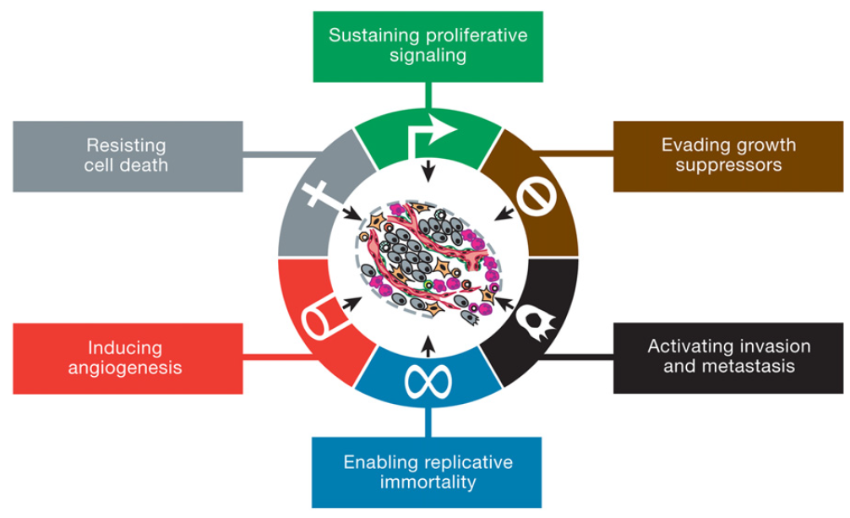
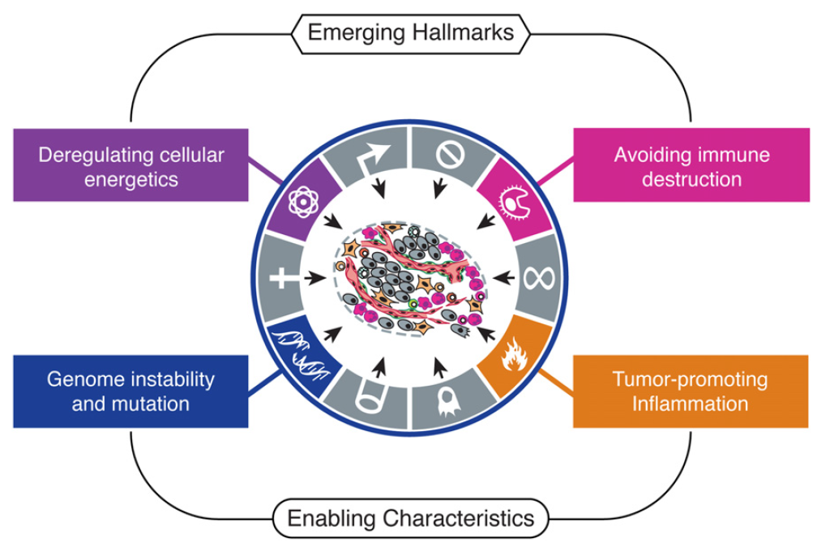
Hallmarks of Cancer
1. Sustaining proliferative signaling
2. Evading growth suppressors
3. Resisting cell death
4. Enabling replicative immortality
5. Inducing aberrant angiogenesis
Activating invasion & metastasis
Emerging Hallmarks
Reprogramming energy metabolism
Evading immune destruction
Enabling Characteristics
Genomic instability and mutation
Inflammation
Hanahan and Weinberg 2011

Slide 17
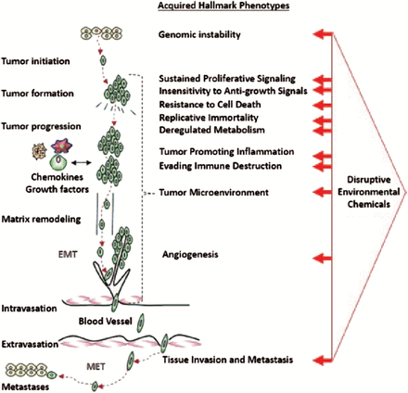
Chemicals and other stressors act at different points on the disease continuum
“Considering the multistep nature of cancer and the acquired capabilities implied by each of these hallmarks, it is therefore a very small step to envision how a series of complementary exposures acting in concert might prove to be far more carcinogenic than predictions related to any single exposure might suggest. Interacting contributors need not act simultaneously or continuously, they might act sequentially...”
Goodson et al. Carcinogenesis. 2015 Jun; 36(Suppl 1): S254–S296.

Slide 18
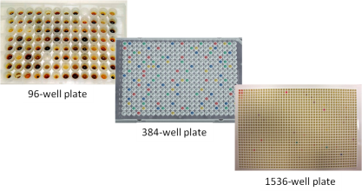
ToxCast Assays (>700 endpoints)
Assay Provider
ACEA
Apredica
Attagene
BioReliance
BioSeek
CeeTox
CellzDirect
Tox21/NCATS
NHEERL MESC
NHEERL Zebrafish
NovaScreen (Perkin Elmer)
Odyssey Thera
Vala Sciences
Biological Response
cell proliferation and death
cell differentiation
Enzymatic activity
mitochondrial depolarization
protein stabilization
oxidative phosphorylation
reporter gene activation
gene expression (qNPA)
receptor binding
receptor activity
steroidogenesis
Target Family
response Element
transporter
cytokines
kinases
nuclear receptor
CYP450 / ADME
cholinesterase
phosphatases
proteases
XME metabolism
GPCRs
ion channels
Assay Design
viability reporter
morphology reporter
conformation reporter
enzyme reporter
membrane potential reporter
binding reporter
inducible reporter
Readout Type
single
multiplexed
multiparametric
Species
human
rat
mouse
zebrafish
sheep
boar
rabbit
cattle
guinea pig
Tissue Source
Lung Breast
Liver Vascular
Skin Kidney
Cervix Testis
Uterus Brain
Intestinal Spleen
Bladder Ovary
Pancreas Prostate
Inflammatory Bone
Detection Technology
qNPA and ELISA
Fluorescence & Luminescence
Alamar Blue Reduction
Arrayscan / Microscopy
Reporter gene activation
Spectrophotometry
Radioactivity
HPLC and HPEC
TR-FRET
Cell Format
cell free
cell lines
primary cells
complex cultures
free embryos
List of assays and related information at: http://www.epa.gov/ncct/

Slide 19
Examples of endpoints used to support conclusions of Goodson et al. - Problem is that assay endpoints don’t match hallmarks
Review team | Chemical name | Disruptive action on key mechanism/pathway | Low-dose effect (LDE, LLDE, NLDE, threshold, unknown)
Angiogenesis | Diniconazole | Vascular cell adhesion molecule and cytokine signaling | Threshold (H-PC) (36 =TOXCAST)
 | Chlorothalonil | Thrombomodulin, vascular proliferation and cytokine signaling | Unknown (H-PC) (36), NLDE (A-in vivo) (38 in Amphibians)
Immune system evasion | Pyridaben | Chemokine signaling, TGF-β, FAK, HIF-1a, IL-1a pathways | Unknown (H-CL, H-PC, A-CL) (36,139,140), threshold (A-I) (141)
 | Triclosan | Chemokine signaling, TGF-β, FAK, IL-1a pathways | Threshold (H-CL, H-PC, A-I) (36,142–144), LDE (A-I, H-CL) (145,146) None of these papers (142-146) show immune evasion

Slide 20
Dilemma: Cancer or Carcinogens
Hallmarks are the biological characteristics of cancer cells and tumors in general, NOT the characteristic properties of human carcinogens
Need to identify the key characteristics of human carcinogens
IARC Working Group did this in 2012 and subsequently scientists at EPA, IARC and elsewhere determined how these characteristics could be searched for systematically

Slide 21
Multiple Mechanisms of Group 1 Carcinogens
[KZ Guyton….MT Smith, Mut Res 681; 230, 2009]
 | Carcinogen
Mechanisms | Aflatoxin B1 | Arsenic | Asbestos | Benzene
DNA damage | + | + | - | +
Gene mutation | + | - | + | -
Chrom mutation | + | + | + | +
Aneuploidy | - | + | + | +
Epigenetic | + | + |  | +
Receptor signaling | - | + | +
Other signaling | - | + |  | +
Immune effects | + | + | + | +
Inflammation | + | + | + | +
Cytotoxicity | + | + | + | +
Mitogenic | - | + |  | -
Gap junction | + | + |  | +

Slide 22
10 Key Characteristics of Human Carcinogens
Key characteristic:
1. Is electrophilic or can be metabolically activated
2. Is genotoxic
3. Alters DNA repair or causes genomic instability
4. Induces epigenetic alterations
5. Induces oxidative stress
6. Induces chronic inflammation
7. Is immunosuppressive
8. Modulates receptor-mediated effects
9. Causes immortalization
10. Alters cell proliferation, cell death, or nutrient supply
Established human carcinogens commonly exhibit one or more characteristics
Data on these characteristics can provide evidence of carcinogenicity
They can also help in interpreting the relevance and importance of findings of cancer in animals and in humans.
Smith MT, Guyton KZ, Gibbons CF, Fritz JM et al.. Env Health Persp., 124(6):713-21

Slide 23
Characteristic | Examples of relevant evidence
1. Is Electrophilic or Can Be Metabolically Activated | Parent compound or metabolite with an electrophilic structure (e.g., epoxide, quinone, etc), formation of DNA and protein adducts.
2. Is Genotoxic | DNA damage (DNA strand breaks, DNA-protein cross-links, unscheduled DNA synthesis), intercalation, gene mutations, cytogenetic changes (e.g., chromosome aberrations, micronuclei).
3. Alters DNA repair or causes genomic instability | Alterations of DNA replication or repair (e.g., topoisomerase II, base-excision or double-strand break repair)
4. Induces Epigenetic Alterations | DNA methylation, histone modification, microRNA expression
5. Induces Oxidative Stress | Oxygen radicals, oxidative stress, oxidative damage to macromolecules (e.g., DNA, lipids)
6. Induces chronic inflammation | Elevated white blood cells, myeloperoxidase activity, altered cytokine and/or chemokine production
7. Is Immunosuppressive | Decreased immunosurveillance, immune system dysfunction
8. Modulates receptor-mediated effects | Receptor in/activation (e.g., ER, PPAR, AhR) or modulation of exogenous ligands (including hormones)
9. Causes Immortalization | Inhibition of senescence, cell transformation
10. Alters cell proliferation, cell death or nutrient supply | Increased proliferation, decreased apoptosis, changes in growth factors, energetics and signaling pathways related to cellular replication or cell cycle control, angiogenesis

Slide 24
Characteristic | Examples of relevant evidence
6. Induces chronic inflammation | Elevated white blood cells, myeloperoxidase activity, altered cytokine and/or chemokine production
7. Is Immunosuppressive | Decreased immunosurveillance, immune system dysfunction
8. Modulates receptor-mediated effects | Receptor in/activation (e.g., ER, PPAR, AhR) or modulation of endogenous ligands (including hormones)
9. Causes Immortalization | Inhibition of senescence, cell transformation, altered telomeres
10. Alters cell proliferation, cell death or nutrient supply | Increased proliferation, decreased apoptosis, changes in growth factors, energetics and signaling pathways related to cellular replication or cell cycle control, angiogenesis

Slide 25
Conclusions in Recent IARC Monographs Evaluations
*Overall evaluation upgraded to Group 2A with supporting evidence from other relevant data

Slide 26
Key Characteristics with Strong Evidence across Multiple Evaluations
(IARC Monographs Vol. 112-119)

Slide 27
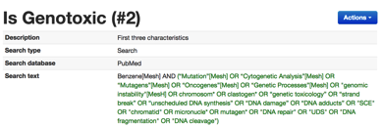
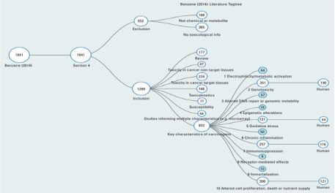
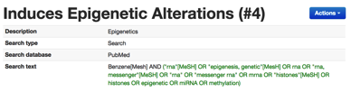
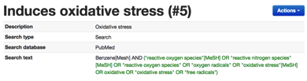

Systematic Approach
Using Key Characteristics of Carcinogens
Targeted searches for each key characteristic
Organize results by key characteristics, species, etc
…
Smith MT, Guyton KZ, Gibbons CF, Fritz JM et al.. Env Health Persp., 124(6):713-21

Slide 28
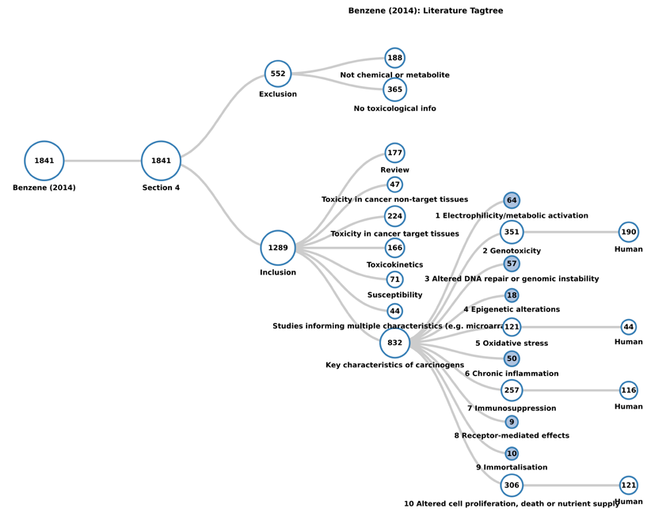
Benzene Mechanistic Data Search conducted using the Health Assessment Workplace Collaborative (HAWC)
Literature Search tool (https://hawcproject.org/)

Slide 29
Benzene Example:
An Adverse Outcome Pathway (AOP)?
Benzene Exposure
PP
ROS
Oxidative DNA Damage
Electrophilic metabolites
AhR Dysregulation
Oxidative Stress
Metabolic Activation
Modulation of receptor
Topo II Inhibition
Inhibition of DNA Repair Pathways
Metabolites induce genomic instability
DNA Damage
Mutations
Chromosome aberrations
Proposed Mode of Action
(Meek and Klaunig)
Genotoxicity
Altered DNA methylation,
miRNA changes, Histone modifications
Altered DNA Repair
Reduced Immune Surveillance
Stem Cell Transformation
Proliferation
Clonal Expansion
Epigenetic alterations
Immunosuppression
Altered Cell Proliferation
Human Leukemia
Rodent Tumors
Notes:
An overview of how benzene induces 8 of the key characteristics in a probable mechanism of carcinogenicity. A full review of these mechanistic data is given in (McHale et al. 2012), from which this Figure was adapted

Slide 30
Benzene Example:
An Adverse Outcome Pathway?
Benzene Exposure
ROS
Oxidative DNA Damage
Electrophilic metabolites
AhR Dysregulation
Oxidative Stress
Metabolic Activation
Modulation of receptor
Topo II Inhibition
Inhibition of DNA Repair Pathways
Metabolites induce genomic instability
DNA Damage
Mutations
Chromosome aberrations
Genotoxicity
Altered DNA methylation,
miRNA changes, Histone modifications
Altered DNA Repair
Reduced Immune Surveillance
Stem Cell Transformation
Proliferation
Clonal Expansion
Epigenetic alterations
Immunosuppression
Altered Cell Proliferation
Human Leukemia
Rodent Tumors
Notes:
An overview of how benzene induces 8 of the key characteristics in a probable mechanism of carcinogenicity. A full review of these mechanistic data is given in (McHale et al. 2012), from which this Figure was adapted

Slide 31
Benzene Example:
An Adverse Outcome Pathway?
Benzene Exposure
ROS
Oxidative DNA Damage
Electrophilic metabolites
AhR Dysregulation
Oxidative Stress
Metabolic Activation
Modulation of receptor
Topo II Inhibition
Inhibition of DNA Repair Pathways
Metabolites induce genomic instability
DNA Damage
Mutations
Chromosome aberrations
Genotoxicity
Altered DNA methylation,
miRNA changes, Histone modifications
Altered DNA Repair
Reduced Immune Surveillance
Stem Cell Transformation
Proliferation
Clonal Expansion
Epigenetic alterations
Immunosuppression
Altered Cell Proliferation
Human Leukemia
Rodent Tumors
Leukemia
Notes:
An overview of how benzene induces 8 of the key characteristics in a probable mechanism of carcinogenicity. A full review of these mechanistic data is given in (McHale et al. 2012), from which this Figure was adapted

Slide 32
Benzene Example:
An Adverse Outcome Pathway?
Benzene Exposure
ROS
Oxidative DNA Damage
Electrophilic metabolites
AhR Dysregulation
Oxidative Stress
Metabolic Activation
Modulation of receptor
Topo II Inhibition
Inhibition of DNA Repair Pathways
Metabolites induce genomic instability
DNA Damage
Mutations
Chromosome aberrations
Genotoxicity
Altered DNA methylation,
miRNA changes, Histone modifications
Altered DNA Repair
Reduced Immune Surveillance
Stem Cell Transformation
Proliferation
Clonal Expansion
Epigenetic alterations
Immunosuppression
Altered Cell Proliferation
Human Leukemia
Rodent Tumors
Notes:
An overview of how benzene induces 8 of the key characteristics in a probable mechanism of carcinogenicity. A full review of these mechanistic data is given in (McHale et al. 2012), from which this Figure was adapted

Slide 33
Benzene Example: An Adverse Outcome Network Involving 8 Key Characteristics
Benzene Exposure
ROS
Oxidative DNA Damage
Electrophilic metabolites
AhR Dysregulation
Oxidative Stress
Metabolic Activation
Modulation of receptor
Topo II Inhibition
Inhibition of DNA Repair Pathways
Metabolites induce genomic instability
DNA Damage
Mutations
Chromosome aberrations
Genotoxicity
Altered DNA methylation,
miRNA changes, Histone modifications
Altered DNA Repair
Reduced Immune Surveillance
Stem Cell Transformation
Proliferation
Clonal Expansion
Epigenetic alterations
Immunosuppression
Altered Cell Proliferation
Human Leukemia
Rodent Tumors
Notes:
An overview of how benzene induces 8 of the key characteristics in a probable mechanism of carcinogenicity. A full review of these mechanistic data is given in (McHale et al. 2012), from which this Figure was adapted

Slide 34
Limitation of MOA/AOP Approach
In the MOA/AOP approach the hypothesized key events are inherently limited by the current understanding of the disease process.
This limitation was recognized by Sir Bradford Hill, who noted that “what is biologically plausible depends upon the biological knowledge of the day” and described the biological plausibility of a suspected causation as ‘helpful’ but not necessary

Slide 35
Key characteristics don’t require assessor to guess the mechanism
Mechanistic hypotheses in science are beneficial because if you test it and are wrong then you modify the hypothesis and get closer to the truth
Mechanistic hypotheses in risk assessment are problematic because if you are wrong you may have made a bad risk decision that cannot easily be changed and may have caused medical or economic harm

Slide 36
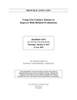
New National Academy of Sciences report
released January 5, 2017
Using 21st Century Science to Improve Risk-Related Evaluations
260 pages | 6 x 9 | PAPERBACK
ISBN 978-0-309-45348-6 | DOI: 10.17226/24635
AUTHORS
Committee on Incorporating 21st Century Science into Risk-Based Evaluations; Board on Environmental Studies and Toxicology; Division on Earth and Life Studies; National Academies of Sciences, Engineering, and Medicine
https://www.nap.edu/download/24635

Slide 37
Using 21st Century Science to Improve Risk-Related Evaluations - Comments
The “approach avoids a narrow focus on specific pathways and hypotheses and provides for a broad, holistic consideration of the mechanistic evidence.” (P.144)
“The committee notes that key characteristics for other hazards, such as cardiovascular and reproductive toxicity, could be developed as a guide for evaluating the relationship between perturbations observed in assays, their potential to pose a hazard, and their contribution to risk.” (p.141)
KCs for reproductive toxicants and endocrine disruptors are being developed by working group

Slide 38
Using 21st Century Science to Improve Risk-Related Evaluations - Recommendation
“The committee encourages the cataloging of pathways, components, and mechanisms that can be linked to particular hazard traits, similar to the IARC characteristics of carcinogens. This work should draw on existing knowledge and current research in the biomedical fields related to mechanisms of disease that are outside the traditional toxicant-focused literature that has been the basis of human health risk evaluations and of assessments and toxicology. The work should be accompanied by research efforts to describe the series of assays and responses that provide evidence on pathway activation and to establish a system for interpreting assay results for the purpose of inferring pathway activation from chemical exposure.” (p.156)

Slide 39

High-Throughput Screening Data
10 Key Characteristics of Human Carcinogens:
1. Is electrophilic or can be metabolically activated
2. Is genotoxic
3. Alters DNA repair or causes genomic instability
4. Induces epigenetic alterations
5. Induces oxidative stress
6. Induces chronic inflammation
7. Is immunosuppressive
8. Modulates receptor-mediated effects
9. Causes immortalization
10. Alters cell proliferation, cell death, or nutrient supply
ToxCast iCSS dashboard
(http://actor.epa.gov/dashboard/)
821 assays
1860 chemicals
??
÷
=
At most, 274 ToxCast/Tox21 assays could be mapped to a key characteristic:
Key characteristic | 1. Is electrophilic or can be metabolically activated | 4. Induces epigenetic alterations | 5. Induces oxidative stress | 6. Induces chronic inflammation | 8. Modulates receptor-mediated effects | 10. Alters cell proliferation, cell death and nutrient supply
Assay Endpoints | 31 assays: CYP inhibition (29) Aromatase inhib. (2) | 11 assays: DNA binding (4) Transformation (7) | 18 assays: Metalloproteinase (5) Oxidative stress (7) Oxidative stress marker (6) | 45 assays: Cell adhesion (14) Cytokines (29) NFkB (2) | 81 assays: AhR (2) AR (11) ER (18) FXR (7) | 68 assays: Cell cycle (16) Cytotoxicity (41) Mitochondrial toxicity (7) Proliferation (4)
Others (18)
PPAR (12)
PXR_VDR (7)
RAR (6)
No assay coverage
for 4 key characteristics
2. Is Genotoxic | 3. Alters DNA repair or causes genomic instability | 7. Is Immunosuppressive | 9. Causes immortalization
Chiu WA, Guyton KZ, Martin MT, Reif DM, Rusyn I. ALTEX., PMID: 28738424.

Slide 40
What Next for the Characteristics?
Refinement of definitions and listing of all assays for each characteristic
Development of HT assays specific for each characteristic – Testing of new drugs and chemicals
Key characteristics of other endpoints – endocrine disruption; cardiovascular toxicity; reproductive toxicity etc.

Slide 41
Question for the Future
If a chemical possesses multiple key characteristics can we classify it as a possible/probable human carcinogen without any animal bioassay or epidemiological data?

Slide 42

Can gene association data and WikiPathways be used to predict the key characteristics and human carcinogenicity?
Linda Rieswijk,
Postdoctoral Researcher,
Smith Lab
Performed cytoscape network comparison having manually assigned pathways to KCs

Slide 43
IARC description | IARC group | Chemical name | Chemical abbreviation | # genes from CTD | # genes chemical-NEO | % of genes related with NEO | # genes in pathways | # pathways | % of genes in pathways
Group 1 - Carcinogenic to humans | 1 | Dioxins | DX | 14875 | 2574 | 17.30 | 1615 | 353 | 62.74
n=15 | 1 | Aflatoxin B1 | AFB1 | 10097 | 1839 | 18.21 | 1099 | 333 | 59.76
 | 1 | Arsenic | AS | 4052 | 912 | 22.51 | 636 | 295 | 69.74
 | 1 | Formaldehyde | FA | 3531 | 787 | 22.29 | 541 | 275 | 68.74
 | 1 | Cadmium | CD | 2549 | 770 | 30.21 | 602 | 301 | 78.18
 | 1 | Trichloroethylene | TCE | 2101 | 517 | 24.61 | 366 | 246 | 70.79
 | 1 | Pentachlorophenol | PCP | 1786 | 369 | 20.66 | 250 | 206 | 67.75
 | 1 | Chromium | CR | 1782 | 521 | 29.24 | 382 | 250 | 73.32
 | 1 | Asbestos | ASB | 1719 | 624 | 36.30 | 480 | 260 | 76.92
 | 1 | Diethylstilbestrol | DES | 1400 | 577 | 41.21 | 427 | 266 | 74.00
 | 1 | Benzene | BZ | 932 | 362 | 38.84 | 278 | 215 | 76.80
 | 1 | Cyclophosphamide | CP | 903 | 426 | 47.18 | 331 | 245 | 77.70
 | 1 | Lindane | BHC | 653 | 277 | 42.42 | 224 | 217 | 80.87
 | 1 | Vinyl Chloride | VC | 155 | 55 | 35.48 | 35 | 55 | 63.64
 | 1 | 4-Aminobiphenyl | 4ABP | 96 | 49 | 51.04 | 27 | 29 | 55.10
Group 2A - Probably carcinogenic to humans | 2A | Diazinon | DZN | 1545 | 451 | 29.19 | 321 | 237 | 71.18
n=10 | 2A | Dieldrin, and aldrin metabolized to dieldrin | DED | 1374 | 389 | 28.31 | 288 | 242 | 74.04
 | 2A | Tetrabromobisphenol A | TBBPA | 979 | 270 | 27.58 | 204 | 211 | 75.56
 | 2A | Dichlorodiphenyltrichloro-ethane | DDT | 735 | 328 | 44.63 | 273 | 229 | 83.23
 | 2A | Glyphosate | GLP | 561 | 175 | 31.19 | 140 | 146 | 80.00
 | 2A | Hydrazine | HYD | 205 | 82 | 40.00 | 38 | 28 | 46.34
 | 2A | Malathion | MAL | 141 | 77 | 54.61 | 65 | 116 | 84.42
 | 2A | N,N-Dimethylformamide | DMF | 58 | 24 | 41.38 | 8 | 7 | 33.33
 | 2A | 2-Mercaptobenzothiazole | MBT | 48 | 34 | 70.83 | 29 | 42 | 85.29
 | 2A | Tetrachloroazobenzene | TCAB | 11 | 10 | 90.91 | 9 | 4 | 90.00
Group 2B - Possibly carcinogenic to humans | 2B | Vinylidene chloride | DCE | 1518 | 440 | 28.99 | 265 | 172 | 60.23
n=8 | 2B | Parathion | PA | 890 | 264 | 29.66 | 166 | 147 | 62.88
 | 2B | N,N-Dimethyl-p-toluidine | DMPT | 566 | 149 | 26.33 | 59 | 73 | 39.60
 | 2B | 2,4-Dichlorophenoxyacetic acid | 24D | 130 | 48 | 36.92 | 37 | 43 | 77.08
 | 2B | 1-Bromopropane | 1BP | 51 | 37 | 72.55 | 30 | 70 | 81.08
 | 2B | Melamine | MA | 28 | 23 | 82.14 | 19 | 52 | 82.61
 | 2B | Pyridine | PYR | 17 | 12 | 70.59 | 8 | 11 | 66.67
 | 2B | Tetrahydrofuran | THF | 4 | 3 | 75.00 | 3 | 1 | 100.00
Group 3 - Not classifiable as to its carcinogenicity to humans | 3 | Acetaminophen | APAP | 9855 | 1961 | 19.90 | 455 | 240 | 23.20
n=8 | 3 | Paraquat | PQ | 2342 | 616 | 26.30 | 486 | 276 | 78.90
 | 3 | Fluorouracil | 5FU | 1455 | 578 | 39.73 | 433 | 257 | 74.91
 | 3 | Coumarin | COU | 222 | 96 | 43.24 | 70 | 111 | 72.92
 | 3 | Diquat | DQ | 180 | 74 | 41.11 | 52 | 102 | 70.27
 | 3 | Chloroquine | CHQ | 159 | 91 | 57.23 | 70 | 111 | 76.92
 | 3 | Reserpine | RES | 126 | 64 | 50.79 | 57 | 94 | 89.06
 | 3 | Ampicilin | AMP | 101 | 54 | 53.47 | 31 | 24 | 57.41
 |  |  |  |  |  | Total # | 355 | 1756

Slide 44
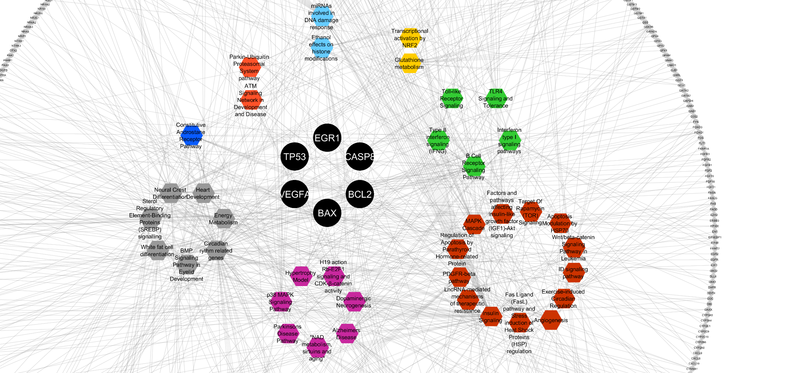
Group 1 (not group 2B nor 2A)
Red nodes = Pathways (80% presence Group 1 → 39)
Blue nodes = Common Genes (80% presence Group 1 → 6)
Light Grey nodes = All Genes (no selection → 422)
0.
1.
3.
4.
5.
7.
10.
11.

Slide 45
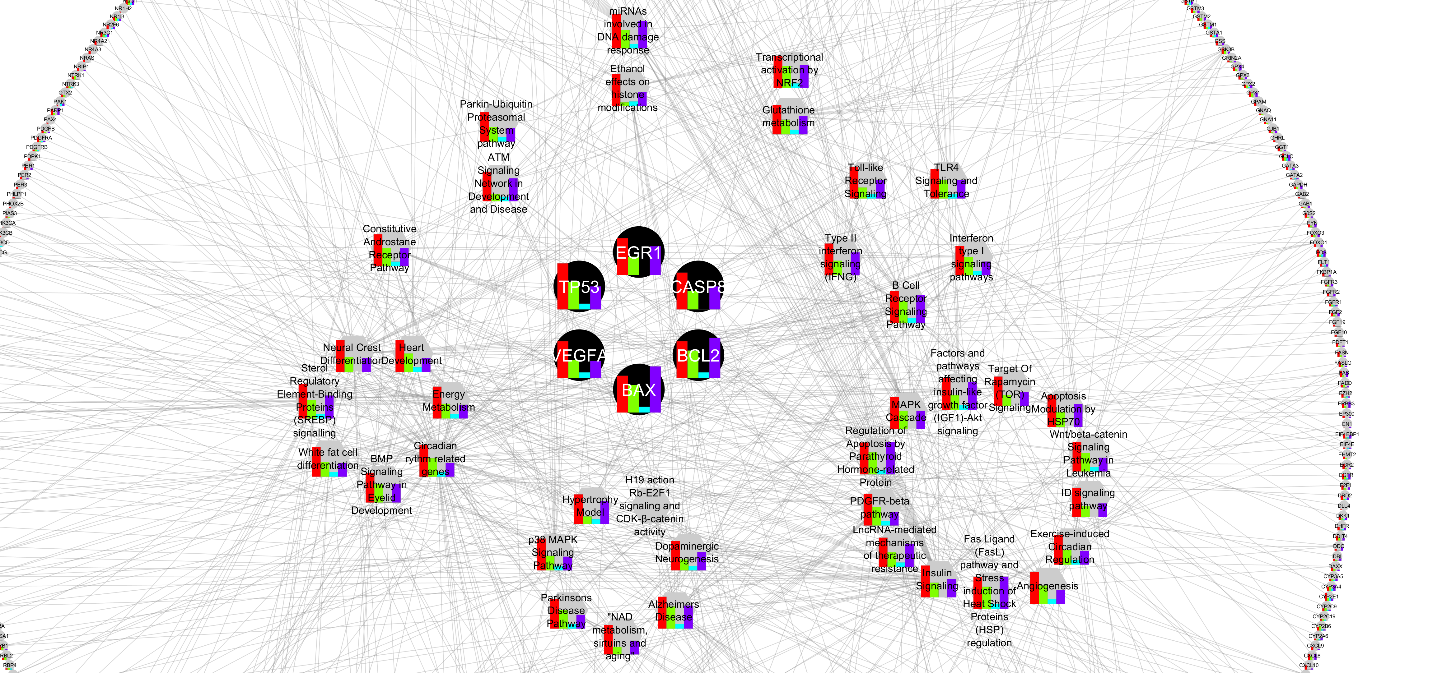
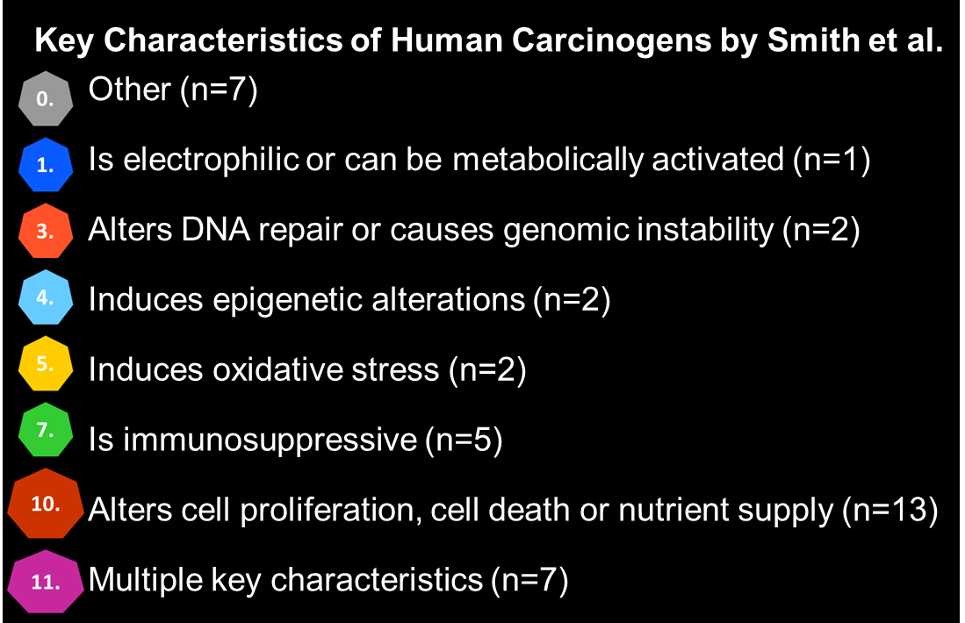
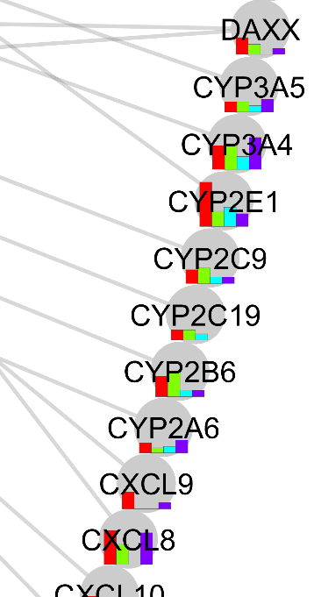

Contribution of each IARC group to the pathways/genes (% from total # chemicals in each group)
4.
5.
3.
7.
1.
Group 1
0.
Group 2A
Group 2B
Group 3
10.
11.

Slide 46

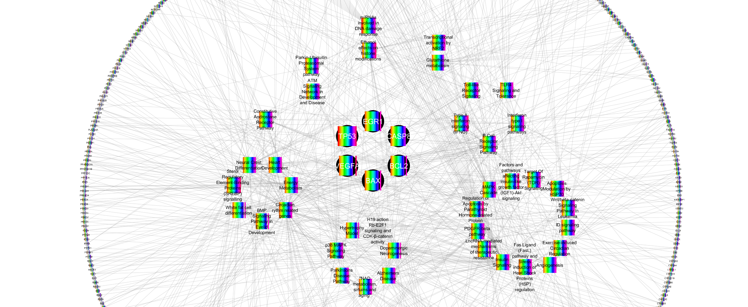
Group 1
KC
Score
4ABP
AFB1
AS
ASB
BHC
BZ
CD
CP
CR
DES
DX
FA
PCP
TCE
VC
0/11
7/11
7/11
6/11
4/11
7/11
7/11
7/11
6/11
7/11
7/11
7/11
6/11
6/11
0/11
4.
5.
3.
7.
1.
0.
10.
11.

Slide 47

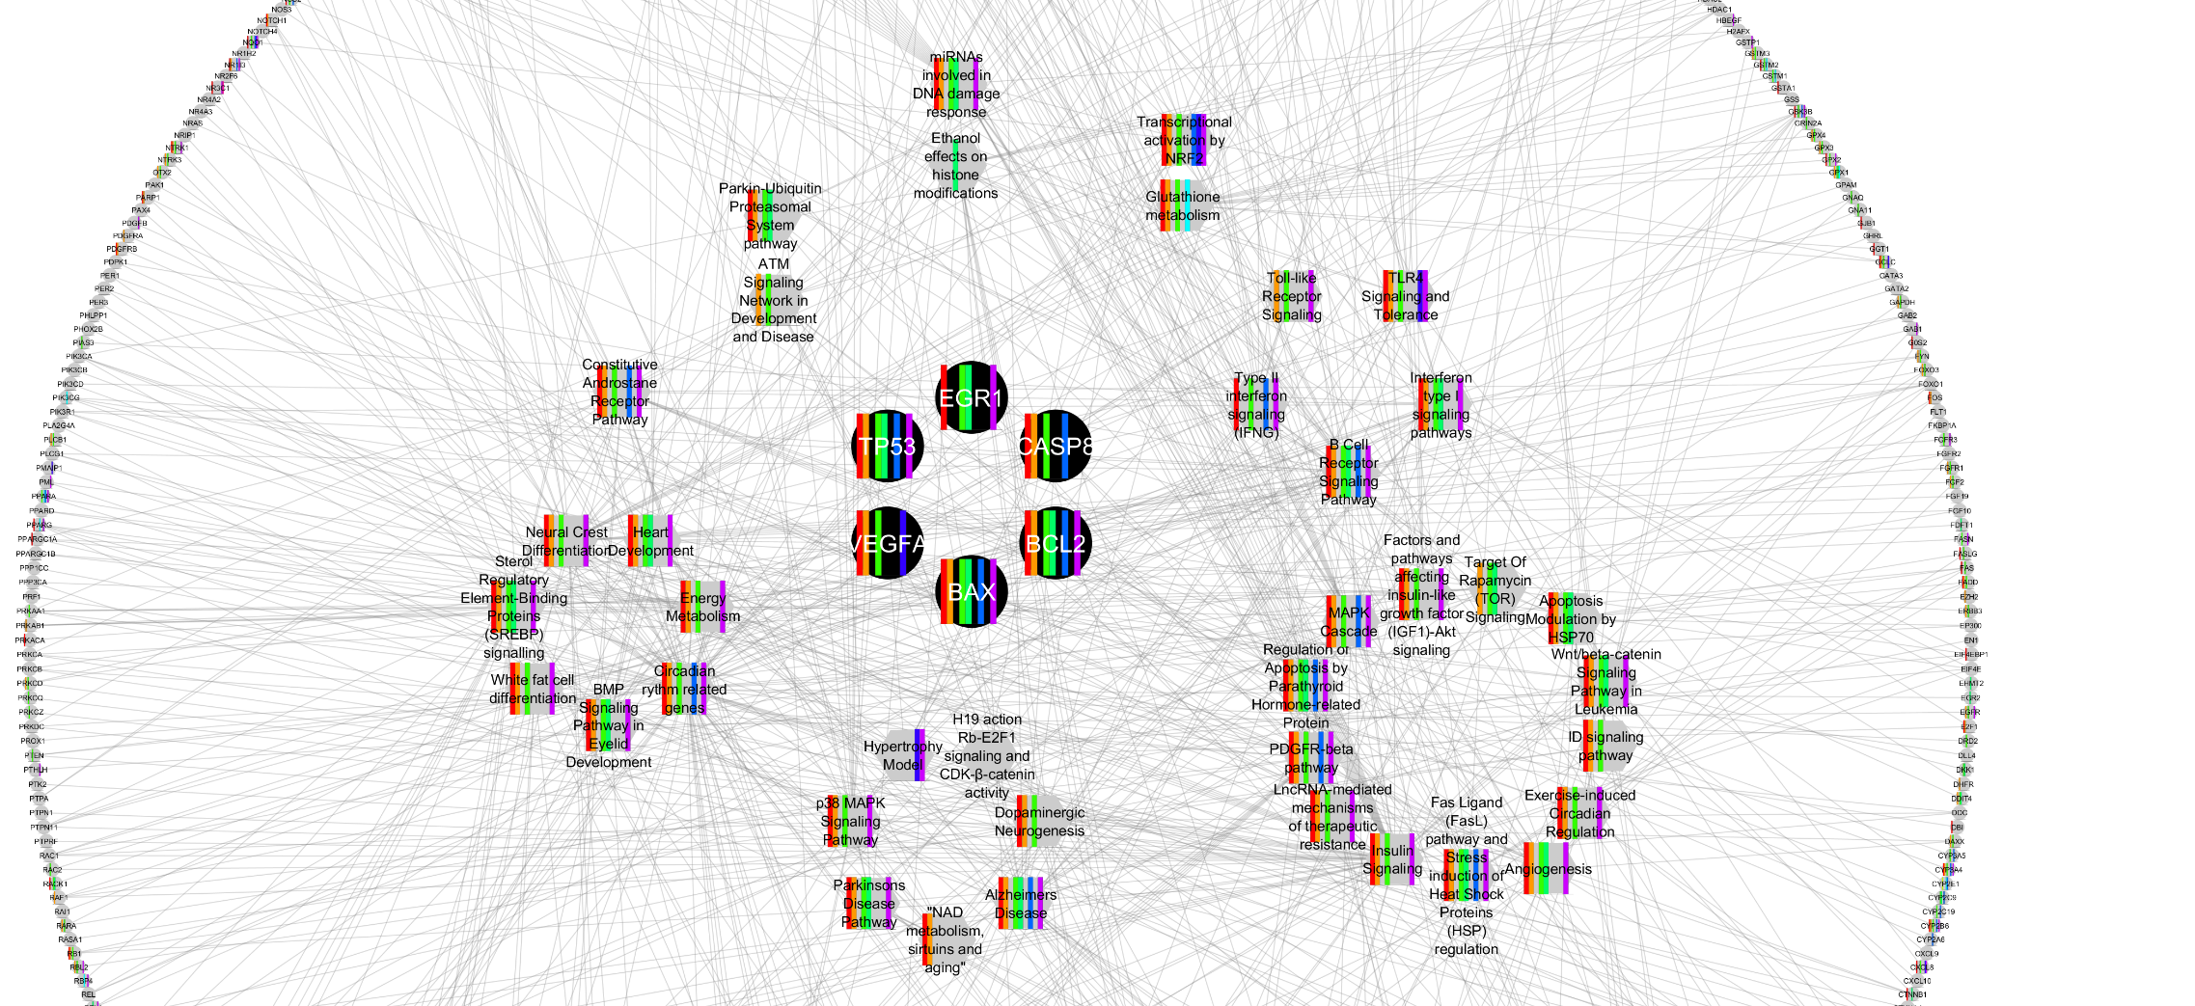
Group 2A
KC
Score
DDT
DED
DMF
DZN
GLP
HYD
MAL
MBT
TBBPA
TCAB
4/11
5/11
0/11
5/11
1/11
0/11
1/11
0/11
2/11
0/11
4.
5.
3.
7.
1.
0.
10.
11.

Slide 48

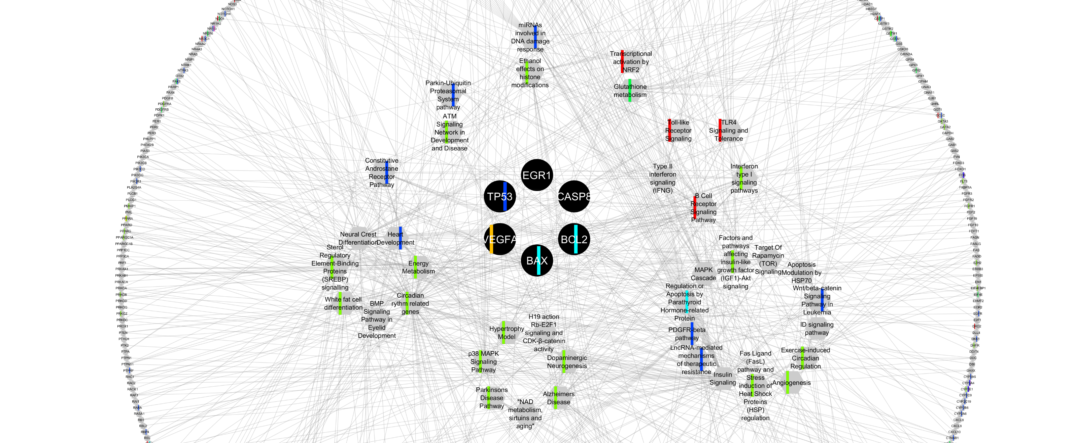
Group 2B
KC
Score
1BP
24D
DCE
DMPT
MA
PA
PYR
THF
0/11
0/11
0/11
0/11
0/11
1/11
0/11
0/11
4.
5.
3.
7.
1.
0.
10.
11.

Slide 49
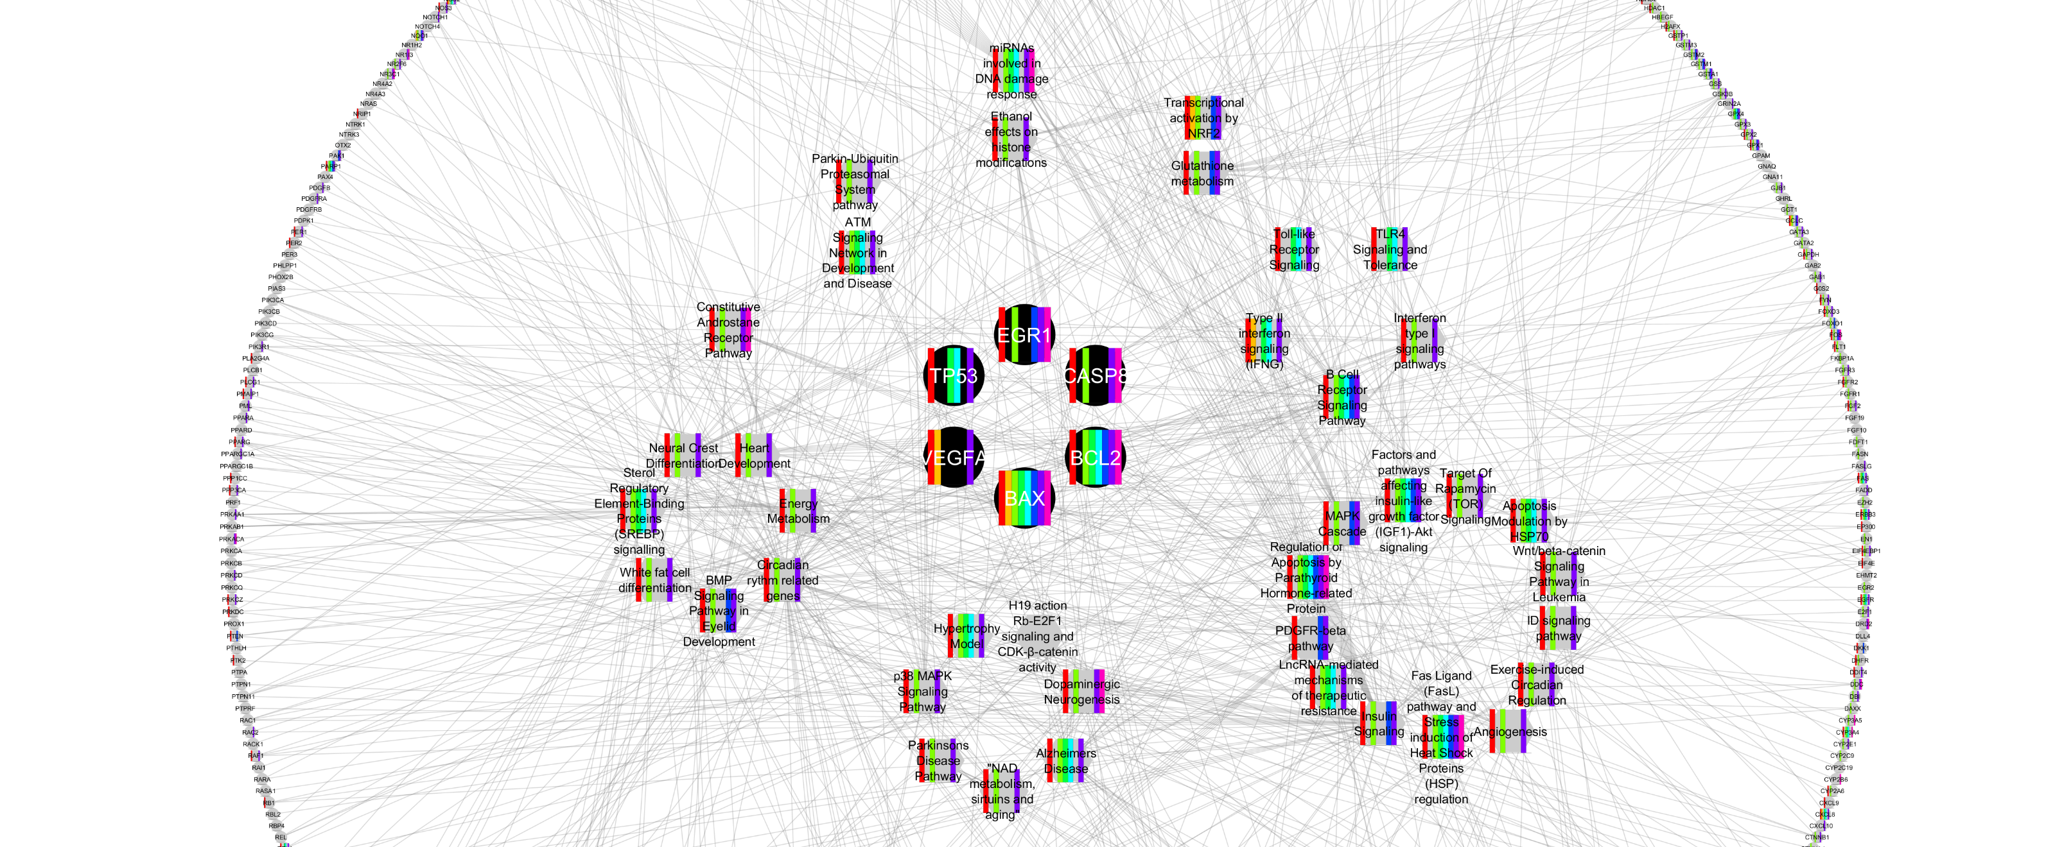
Group 3
KC
Score
5FU
AMP
APAP
CHQ
COU
DQ
PQ
RES
7/11
0/11
6/11
0/11
0/11
1/11
7/11
1/11
4.
5.
3.
7.
1.
0.
10.
11.

Slide 50
Summary
Scientific findings providing insights into cancer mechanisms play an essential role in carcinogen hazard identification
The key characteristics of known human carcinogens provide the basis for an objective, systematic approach for identifying and evaluating mechanistic data
Shows carcinogens tend to act through multiple mechanisms in producing human and animal tumors
Recent IARC Monographs evaluations have illustrated the applicability of this approach
May be compatible with HT assays, but need to develop new ones based on characteristics and hallmarks. Same for biomarkers.
Key characteristics for other forms of toxicity could be developed

Slide 51
A Large Collaboration
IARC: Kathryn Z. Guyton, Robert Baan and Kurt Straif
US EPA: Catherine Gibbons, Jason Fritz, David DeMarini, Jane Caldwell, Robert Kavlock, Vincent Cogliano
NTP: John Bucher FDA: Frederick Beland
Academia: Ivan Rusyn, Paul F. Lambert, Stephen S. Hecht, Bernard W. Stewart, Weihsueh Chiu, Denis Corpet, Martin van den Berg, Matthew Ross, David Christiani, Linda Rieswijk
EDF: Christopher Portier
Acknowledgements: Michele La Merrill for discussion and support from NIEHS SRP grant P42ES004705 and travel awards from IARC.

